Slide 1
Time Series Data Mining Tool
Samir Sheriff, Satvik N, Vaishakh B N
under the guidance of
Mrs. Shanta Rangaswamy

Slide 2
Abstract
Data mining
Time series Analysis
Design Patterns
Version Control

Slide 3
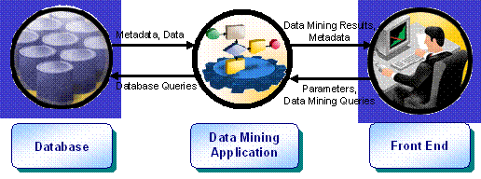

Slide 4
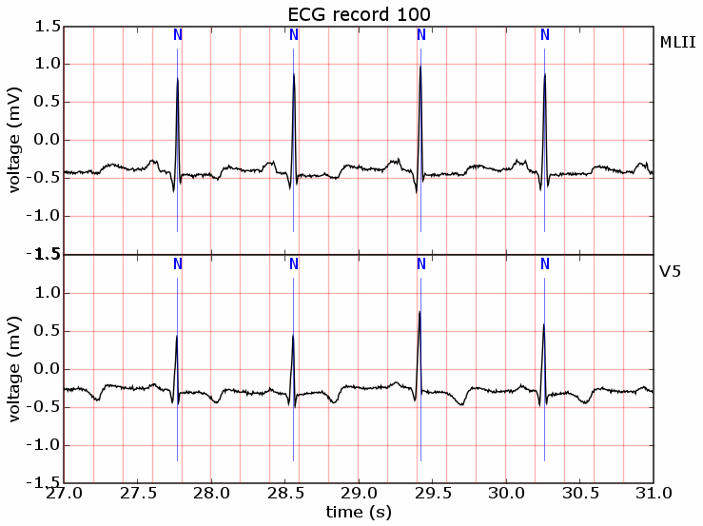
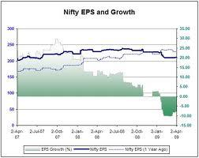
What are Time Series?
A sequence of data points, measured typically at successive points in time spaced at uniform time intervals.

Slide 5
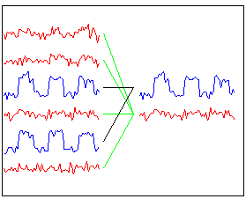
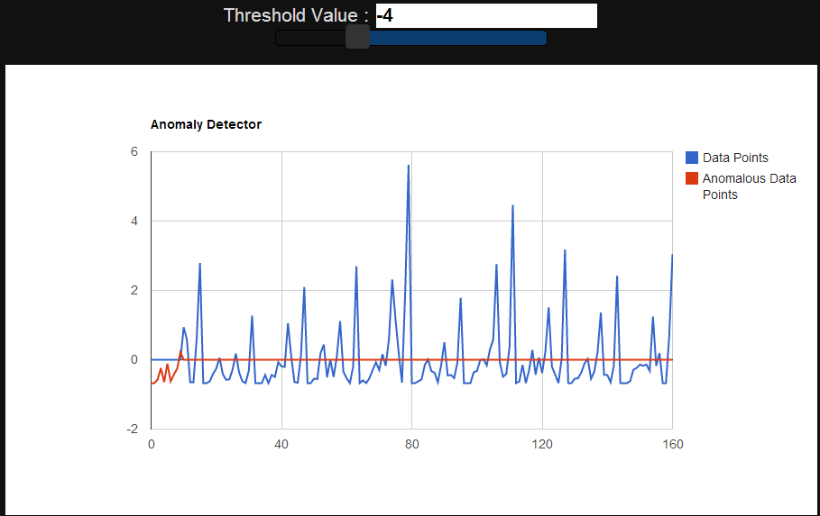
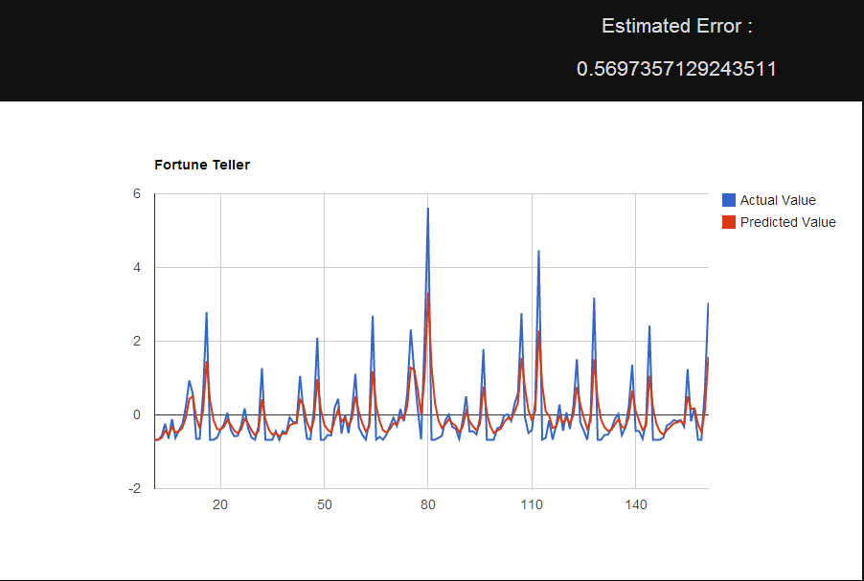
Time Series Analysis
Methods for analyzing time series data in order to extract meaningful statistics and other characteristics of the data.
In the context of data mining, pattern recognition and machine learning time series analysis can be used for clustering, classification, anomaly detection as well as forecasting.

Slide 6
Datasets considered
Rainfall
Sea Level
Electricity
ECG

Slide 7
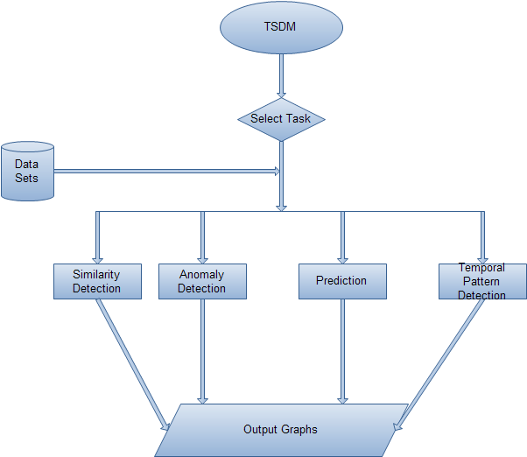
System Architecture

Slide 8
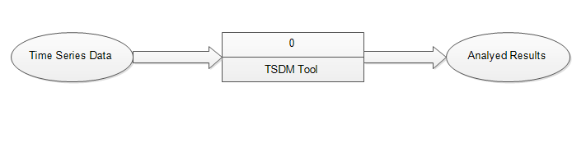
DFD Level 0

Slide 9
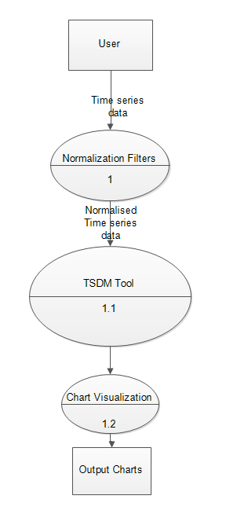
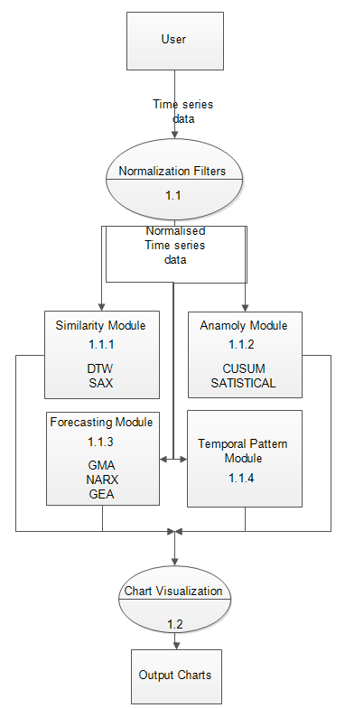
DFD Level 1.1
DFD Level 1

Slide 10
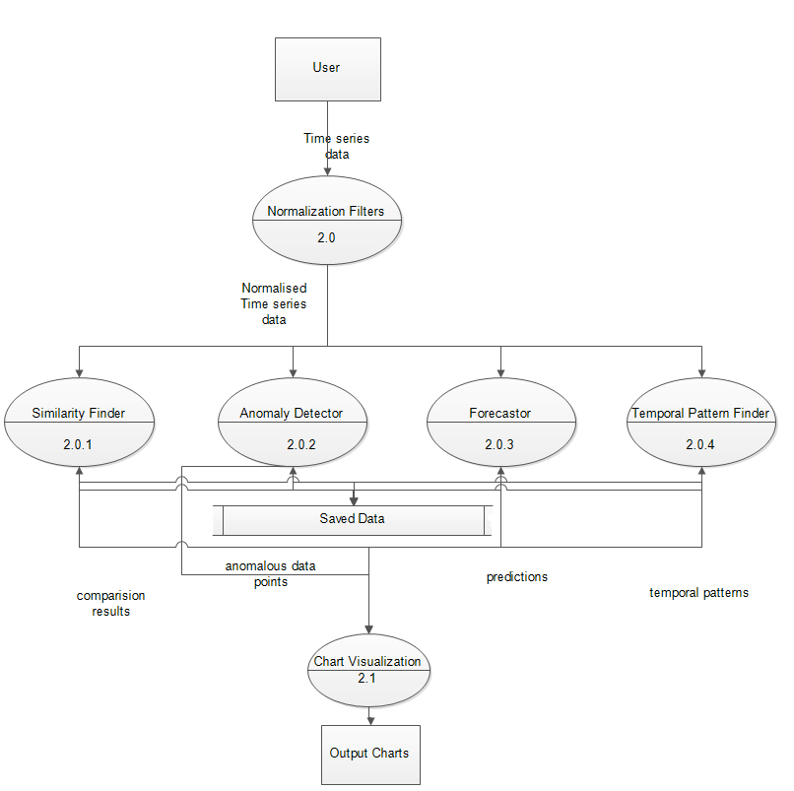
DFD Level 2

Slide 11
Anomaly Detection
Detecting patterns in a given data set that do not conform to an established normal behavior.
The patterns thus detected are called anomalies
Often translate to critical and actionable information in several application domains.
Approaches
CUSUM
Statistical

Slide 12
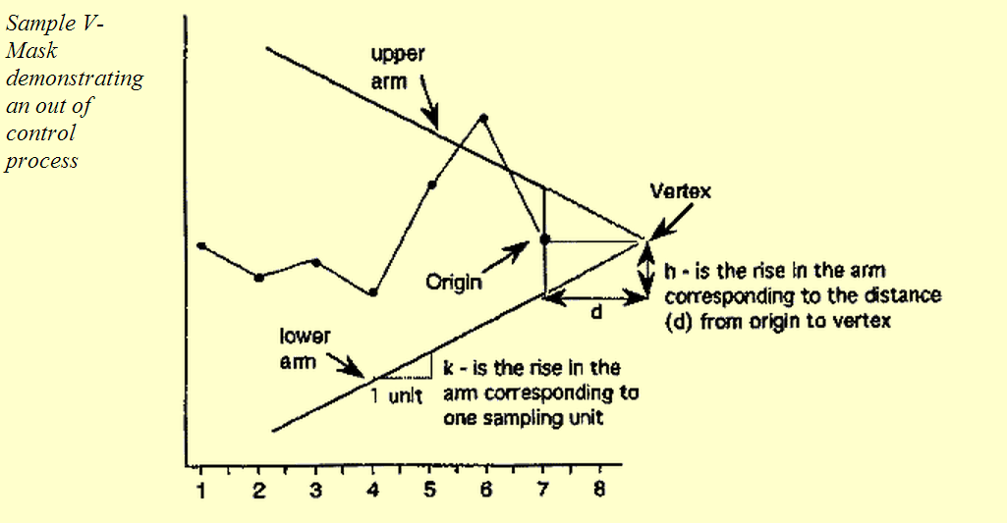
CUSUM VMASK APPROACH
Let us collect m samples, each of size n,
Compute the mean of each sample.
Then the cumulative sum (CUSUM) control chart is formed by plotting one of the following quantities:

Slide 13
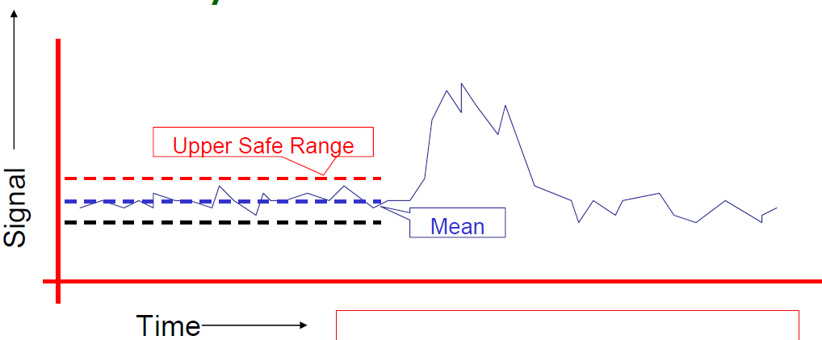
Statistical Approach
Dealt with by Statistical Quality Control
Record the mean and standard deviation up the the current time.
Signal an alarm if we go outside 3 sigmas

Slide 14
Similarity Detection
Given a query time series Q, find the most similar time series in a given collection of time series.
With Clustering, natural groupings of time series can be obtained.
Algorithms
DTW
SAX

Slide 15
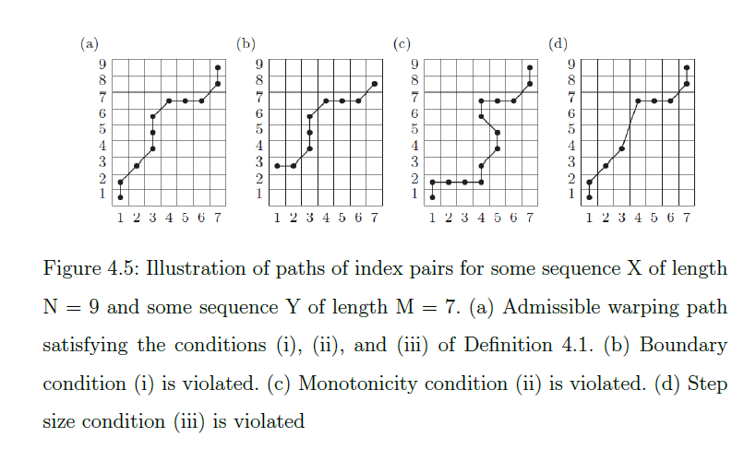
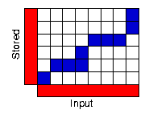
DTW (Dynamic Time Warping)
Method to find an optimal match between two time series with certain restrictions.
The sequences are "warped" non-linearly in the time dimension
to determine a measure of their similarity independent of certain non-linear variations in the time dimension.

Slide 16
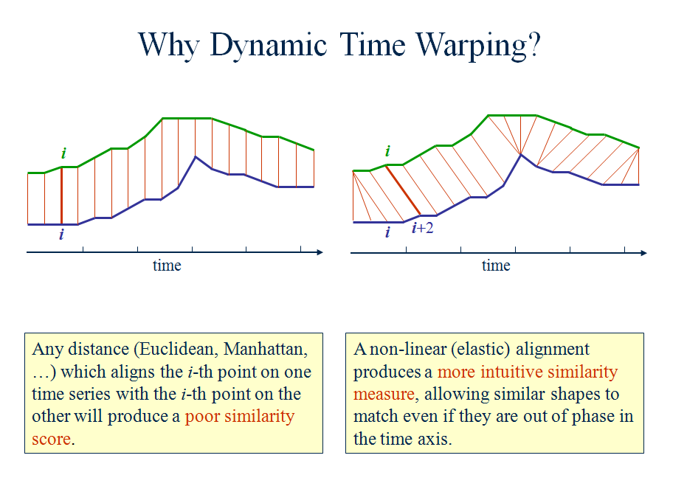

Slide 17
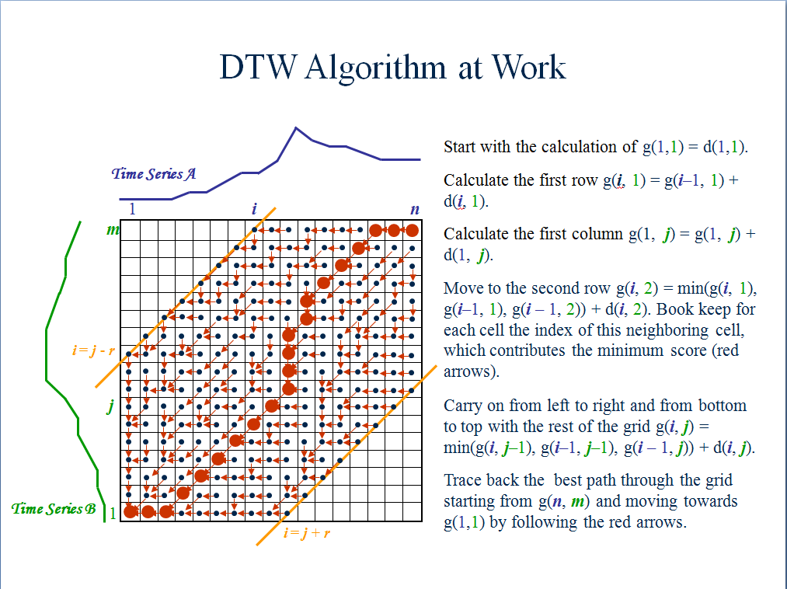
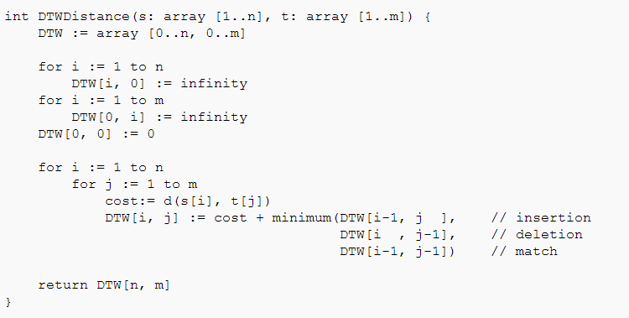

Slide 18
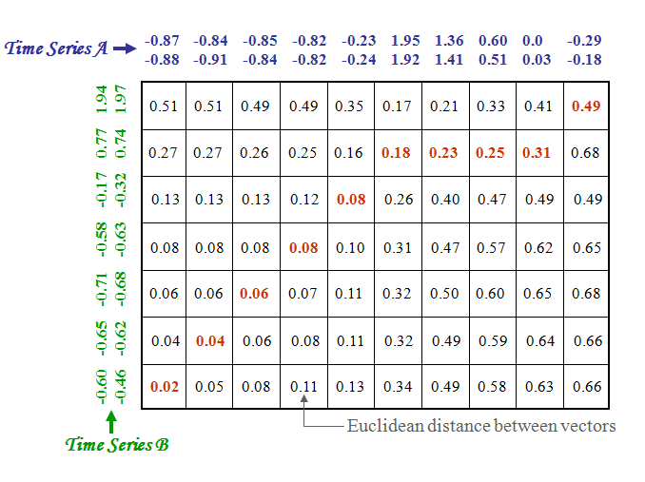
Example

Slide 19
SAX Representation
Symbolic Aggregate approXimation
Dimensionality of the symbolic representation is less than the original data
Allows a time series of arbitrary length n to be reduced to a string of arbitrary length w (w<n)
Intermediate representation between the raw time series and symbolic strings

Slide 20
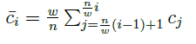
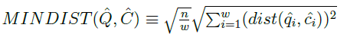
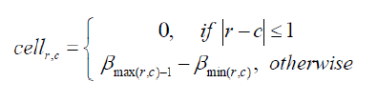
Dimensionality Reduction Via PAA
A time series C of length n
`
Obtaining Breakpoints
determine the breakpoints that will produce a equal-sized areas under Gaussian curve.
Discretization
All PAA coefficients that are below the smallest breakpoint are mapped to the symbol a
can be represented in a w-dimensional space by a vector C
The i^{th} element of C is calculated by the following equation:
All coefficients greater than or equal to the smallest breakpoint and less than the second smallest breakpoint are mapped to the symbol b,
Etc
Distance Measure
dist() function can be implemented using a table lookup
`

Slide 21

Forecasting
Use of a model to predict future values based on previously observed values.
Algorithms
NARX Neural Network
Moving Average
Simple
Geometric
Exponential

Slide 22
Moving Averages
Given a series of numbers and a fixed subset size,
The first element of the moving average is obtained
by taking the average of the initial fixed subset of the number series.
The Geometric moving average calculates the geometric mean of the previous N bars
The geometric mean on the other hand is calculated by multiplying the time series' N previous values and then taking the N'th root.
Legacy algorithms that do not really yield promising results.

Slide 23
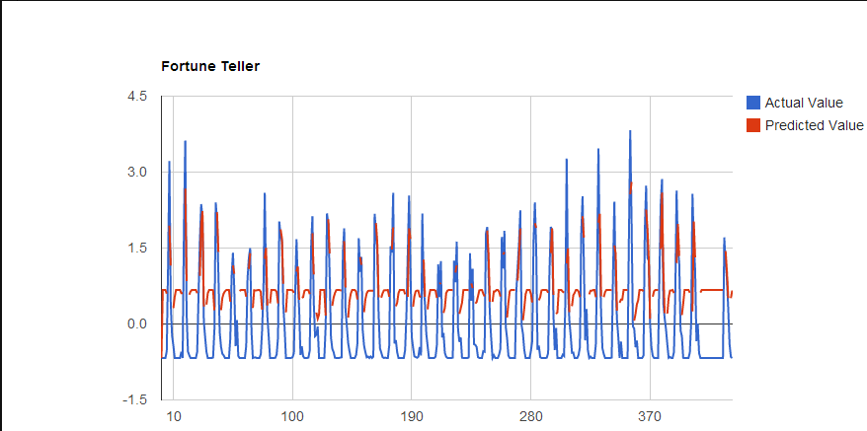
Example : Moving geometric on Rainfall Data
The predicted value is very close to the actual value.
Final Predicted : 1.44
Final Actual : 1.7
Error : 17% (Error percentage changes for different data sets)

Slide 24
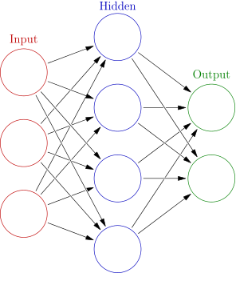
NARX Neural Network
In machine learning and computational neuroscience, an artificial neural network is a mathematical model inspired by biological neural networks. A neural network consists of an interconnected group of artificial neurons, and it processes information using a connectionist approach to computation.
Neural networks are used for modeling complex relationships between inputs and outputs or to find patterns in data.
In time series modeling, a nonlinear autoregressive exogenous model (NARX) is a nonlinear autoregressive model which has exogenous inputs.
The model predicts the current value of a time series using :
past values of the same series
current and past values of the driving (exogenous) series
Mathematically

Slide 25
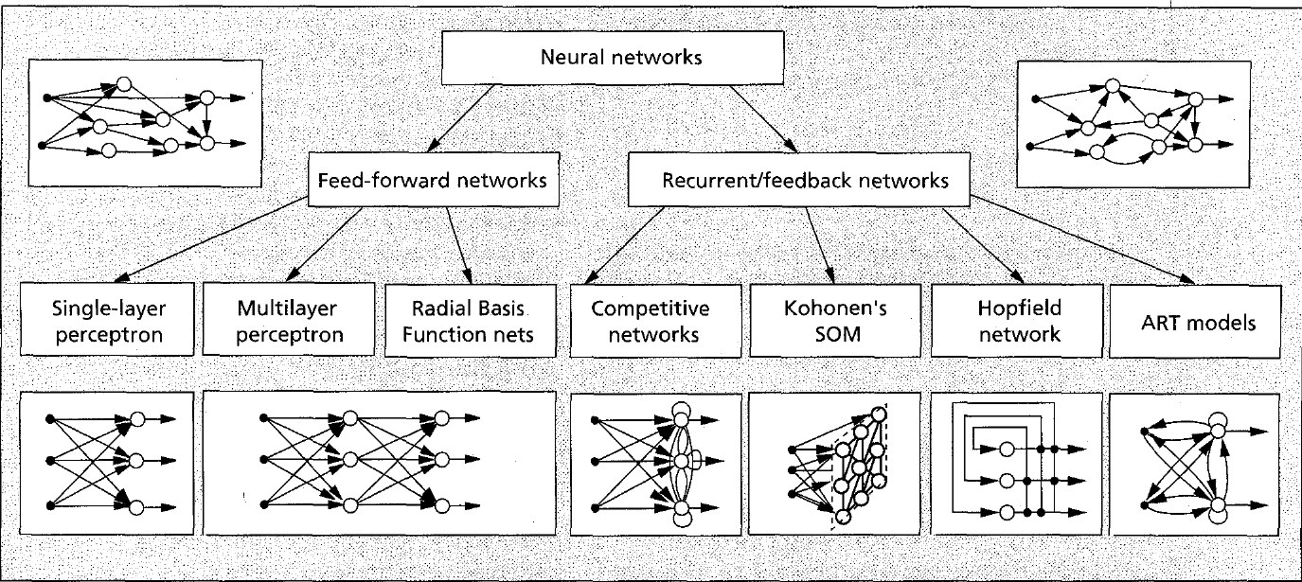
Types of Neural Network

Slide 26
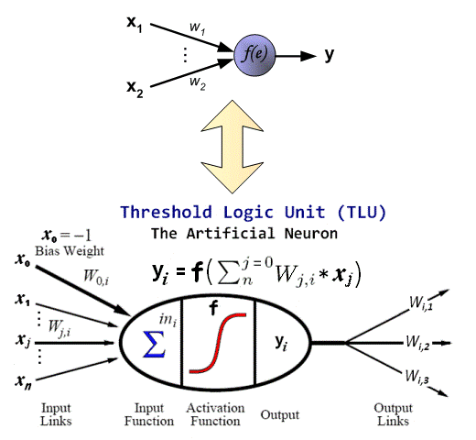
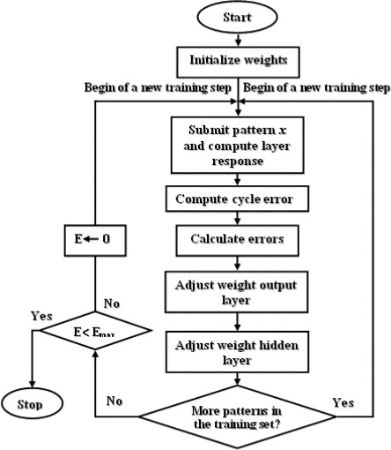
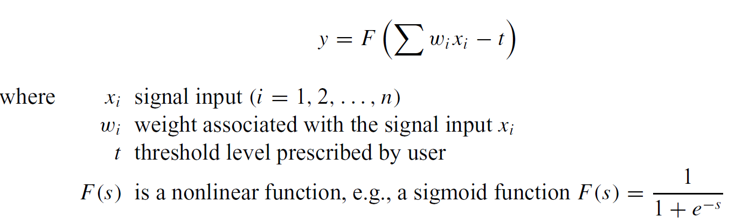
Training with Back Propagation

Slide 27
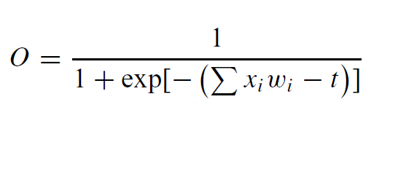
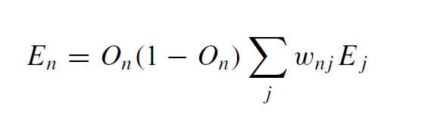
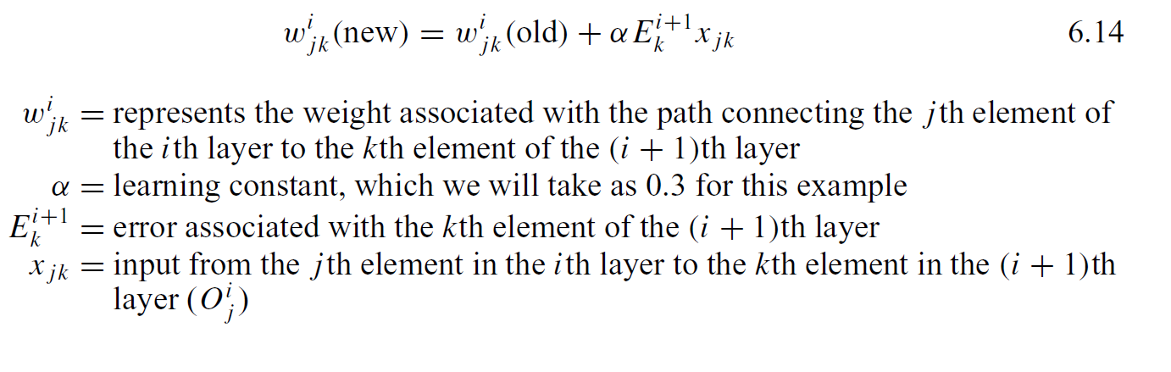
Compute Neuron Outputs
Compute and Propagate Errors
Update Weights

Slide 28
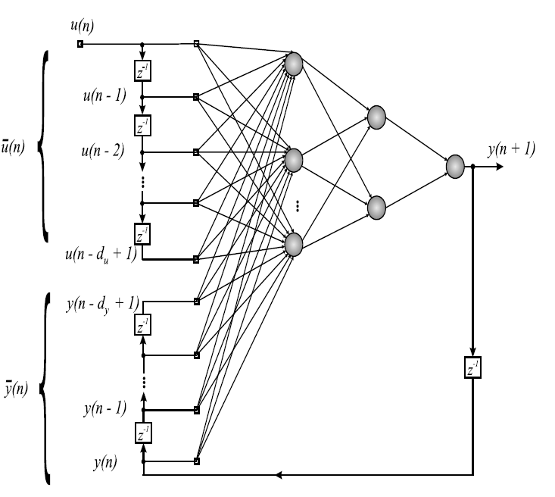
Overview of the NN Architecture in TSDM Tool

Slide 29
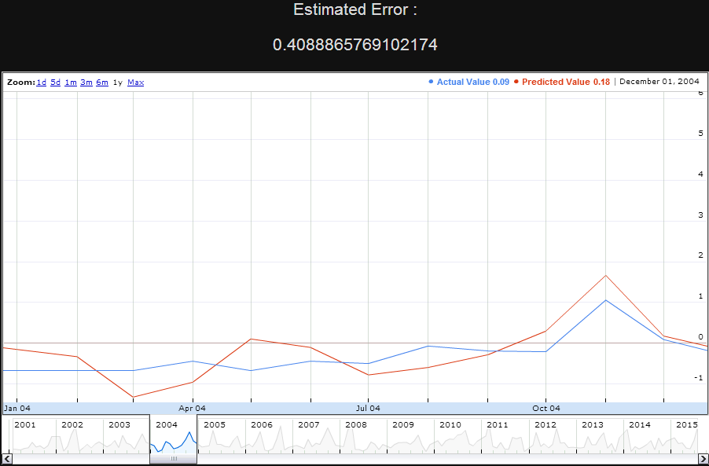
NARX NN Prediction in TSDM Tool

Slide 30
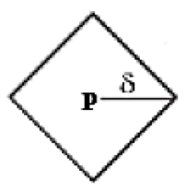
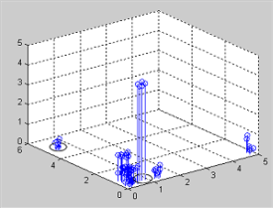
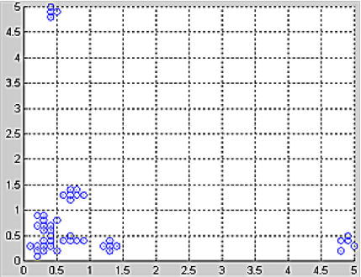
Temporal Pattern Mining
Concepts
Event
Indication of an important occurrence
Temporal Patterns
Hidden structure in a time series that is characteristic
and predictive of events
Phase Space
Geometric representation of a time series viewed in 2 or more dimensions
Event Characterization
g(t)
Value at t correlates highly with the occurrence of an event at some point in the
future
Augmented Phase Space
Phase space is extended an extra
dimension to a Q+1 dimensional space with g(t)
Objective Function
Evaluating
and assigning fitness values to candidate solutions.
Temporal Pattern Clusters Set of all points within Manhattan distance d of the temporal pattern

Slide 31
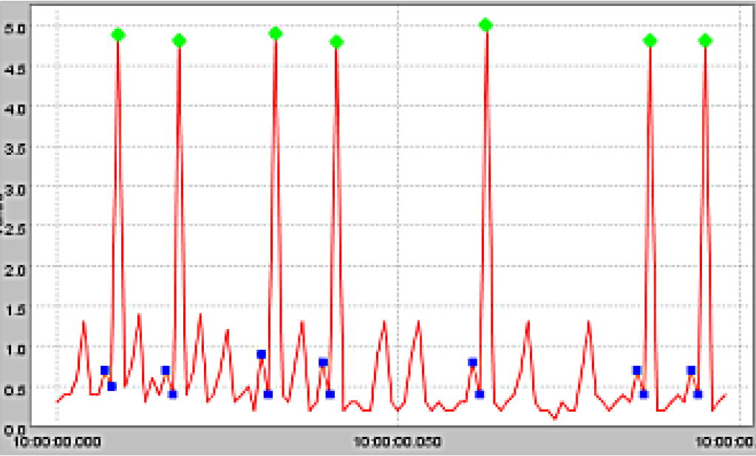
Events and Temporal Patterns

Slide 32

Introduction Genetic Algorithms
Genetic Algorithms (GAs) have been successfully applied to solve search and optimization problems.
A GA generally has four components.
The basic idea of a GA is to search a population of solutions to find the best solution.
A pool of initial solutions called a population is randomly generated and each solution is evaluated with a fitness function.
Population
Fitness function
Selection function
Genetic operators such as mutation and crossover.

Slide 33
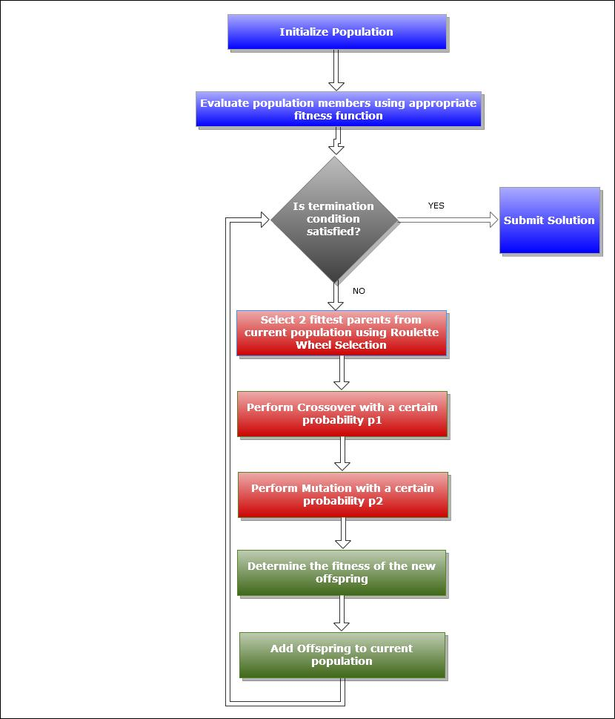
A Typical GA Procedure

Slide 34
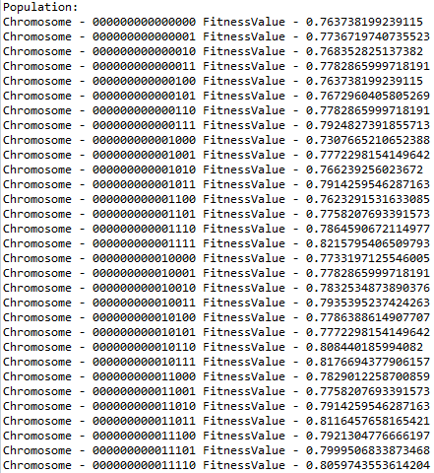
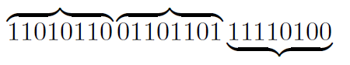
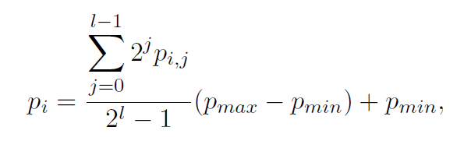
Step by Step execution of the DT-GA based Algorithm
Chromosomes
Initial Selection of the Population – A collection of bit strings (genomes) are selected indicating the a candidate solution of size (Q + 1) * length
For eg., for Q=2 and allele size = 8 bits;
The fitness value of the chromosome is indicated by objective function.
The candidate solution decodes to point p and distance d

Slide 35
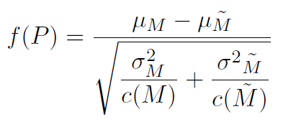
Frame Goal in terms of Event Characterization Function
Define the event characterization function g.
g(t) = x_{t+1}
Define the objective
function f.
Statistical T-Test
M is the set of all time indices t when x _{t} is within the
temporal pattern cluster

Slide 36
Determine Length of Temporal Pattern
Determine the length Q of the temporal patterns we wish to discover.
This also determines the number of dimensions in the phase space.
Q = 2

Slide 37

Construct Phase Space
Unfold time series X unto a two dimensional phase space
(Q = 2) using the time-delay embedding process.
Each pair of serial points (x_{t-1}, x_{t}) in X
generates a single two dimensional phase space point.

Slide 38
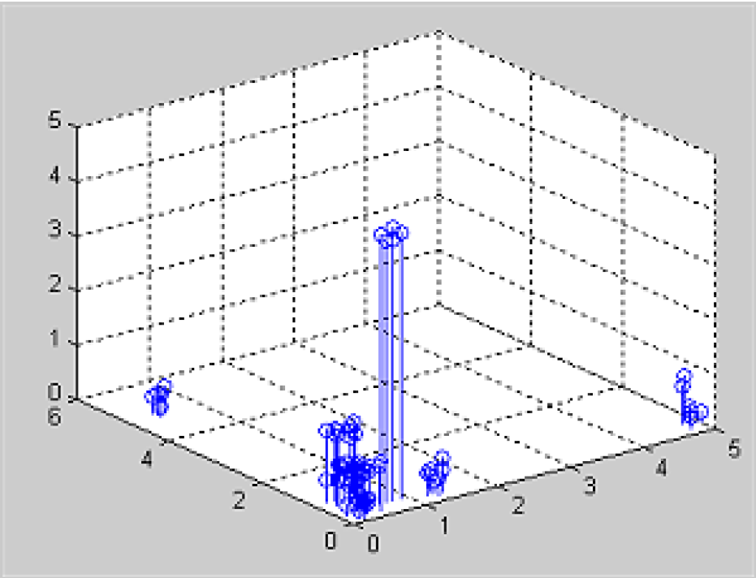
Form Augmented Phase Space
Extend the two dimensional phase space an extra dimension using the event
characterization function g(·)
The vertical axis represents the eventness
associated with a single phase space point (x_{t-1}, x_{t}) .

Slide 39
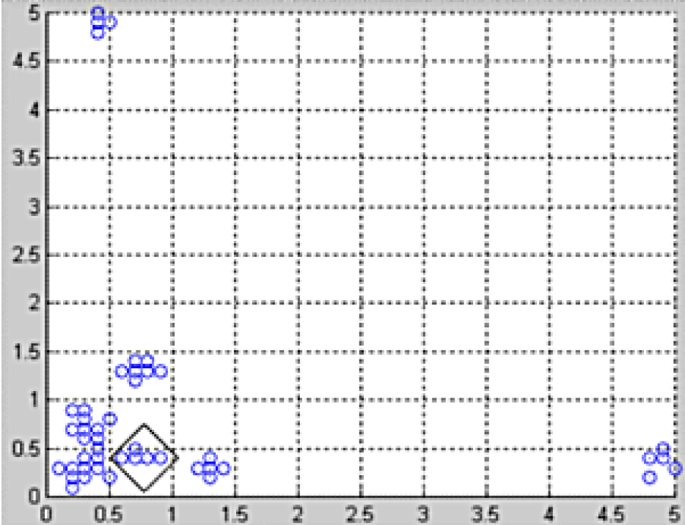
Search for Optimal Pattern Cluster
A genetic algorithm ‘searches’ the augmented phase space for the optimal pattern cluster.
A cluster P has a centre defined by a temporal pattern p
and a radius d.
We also determine the parameters for the genetic algorithm prior to executing.

Slide 40

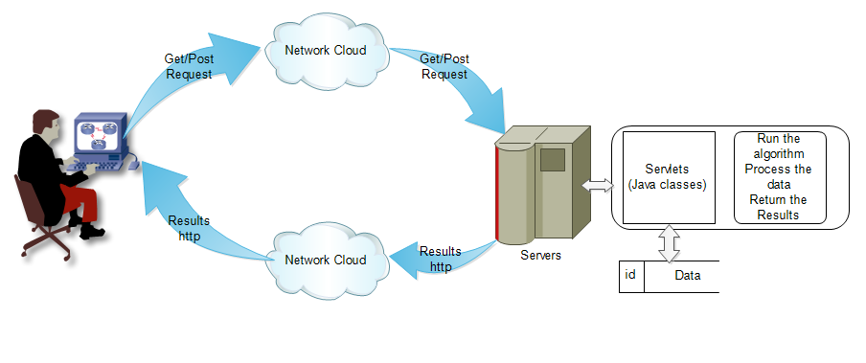
High Level Design Of the TSDM Tool
Implemented with J2EE

Slide 41
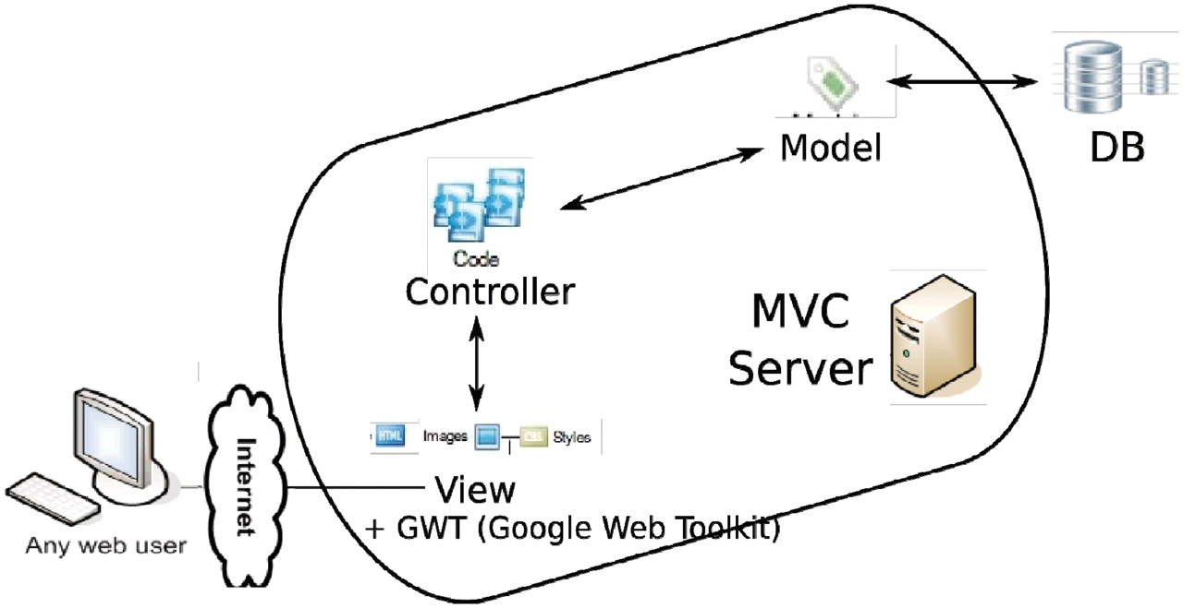
MVC Design Pattern
Model–view–controller (MVC) is a software architecture pattern which separates the representation of information from the user's interaction with it.

Slide 42
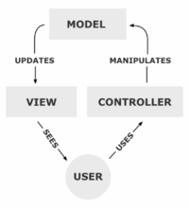
View
HTML, CSS, JS, jQuery(UI), JSP, AJAX, Google Charts API
Controller
Servlets
Model Beans
TSDM Tool

Slide 43
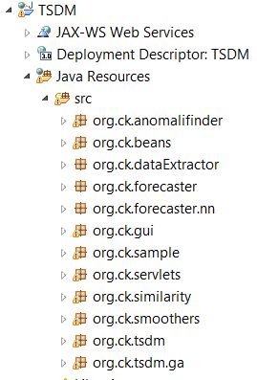
Object-Oriented Module Design
org.ck.sample
org.ck.forecaster.nn
org.ck.smoother
org.ck.similarity
org.ck.anomalifinder
org.ck.tsdm
org.ck.tsdm.ga
org.ck.beans
org.ck.servlets
org.ck.gui
Packages – There are ten main packages in this project.

Slide 44
EXPERIMENTAL DATASET
Monthly Rainfall data from 6 taluks of Chikkaballapur District of Karanataka.
Collected from 2000-2010
Shidlaghatta
Bagepalli
Chikkaballapura
Gowribidanuru
Gudibanda
Chintamani

Slide 45
WHAT IS DONE WITH THE DATA SETS?
SIMILARITY USING DTW AND SAX
ANOMALY USING CUSUM AND STATISTICAL APPROACH
PREDICTION USING MEA AND NARX NEURAL N/W
TEMPORAL PATTERN DETECTION

Slide 46
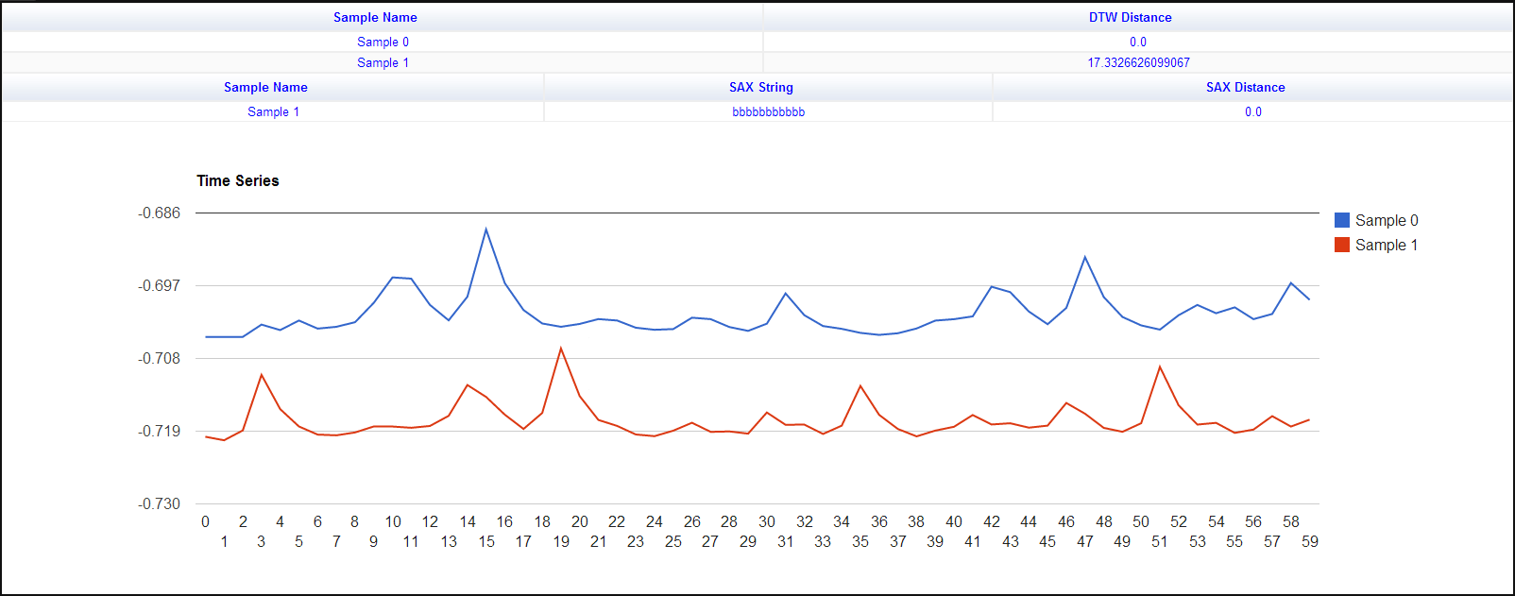
SIMILARITY DETECTION
Similarity detection of two Samples of five years each using SAX
and DTW Algorithm for Shidlaghatta Taluk
DTW distance of 17.33. (Lesser the DTW distance, more the similarity between the two.)

Slide 47
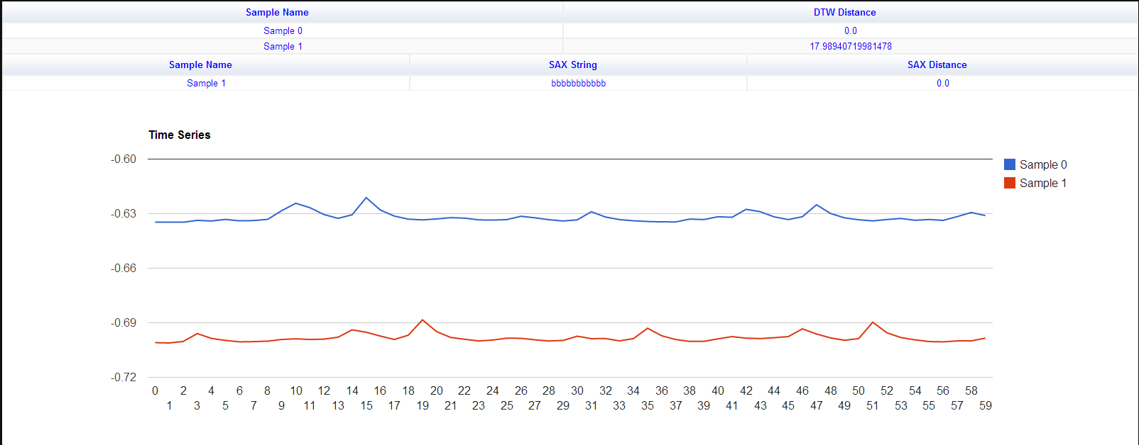
SIMILARITY USING SAX
Similarity detection of two Samples of five years each using SAX
and DTW Algorithm for Gowribidanur Taluk .

Slide 48
ANOMALY DETECTION USING CUSUM
Anomaly detection using the Cumulative Sum Approach for Rain-
fall data set of Bagepalli Taluk. Red shows anomaly

Slide 49

ANOMALY USING STATISTICAL APPROACH
Anomaly detection using the Statistical Approach for rainfall data
set of Gowribidanuru taluk.

Slide 50

FORECASTING USING NARX-NEURAL N/W
Forecasting/Estimation using NARX Neural Network Approach
for Rainfall data set of Shidlaghatta taluk. Period: 2006-2008

Slide 51
FORECASTING USING MEA
Forecasting/Estimation using Moving Exponential Average
Method for rainfall data set of Bagepalli Taluk. Error: 56%

Slide 52

TEMPORAL PATTERNS
Temporal Patterns detected in the Rainfall/Water Data

Slide 53
Future Enhancements
The size of the time series data analyzed is in terms of Mega Bytes. For larger dataset(In terms of GBs) or big data, distributed computing technologies like Hadoop can be used.
Advantages
Neat and Clean Intuitive UI.
User can upload any data and analyze with the tool.
Google chart Visualization
The application can be extended to analyze multi variate time series data.

Slide 54


THANK YOU
Team Collaboration and Version Control
Source code available at https://github.com/nsatvik/ts-datamining
© 2013,Code Kshetra Inc.

